Slide 1

AIOS：LLM AGENT OPERATING SYSTEM
BUSINESS DESIGN
Ziyan Qiu(Elvira)

Slide 2

01 . INTRODUCTION
CONTENT
BUSINESS DESIGN
02 . RELATED WORK
03 . CONCLUSIONS

Slide 3
PART01
BUSINESS DESIGN
INTRODUCTION
The paper describes AIOS, an LLM agent operating system designed to integrate and optimize the use of large language models within an OS environment.

Slide 4


WHAT
The paper describes AIOS, an LLM agent operating system designed to integrate and optimize the use of large language models within an OS environment.
HOW
AIOS integrates LLMs into OS to optimize resource allo-cation, facilitate context management, and enable concurrent multi-agent execution.
USING
AIOS addresses several core challenges in the deployment of LLM-based agents, including sub-optimal scheduling, resource allocation, context main-tenance, and the integration of heterogeneous agents.

Slide 5
PART02
BUSINESS DESIGN
RELATED WORK
Evolution of Operating Systems， Large Language Model Agents，and Requirements Definition Work.

Slide 6



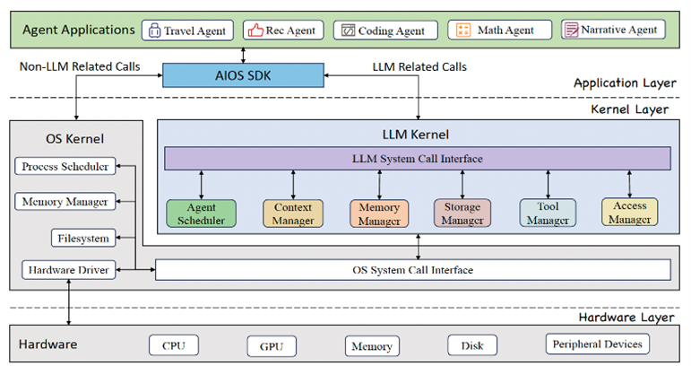
Large Language Model Agents
The AIOS architecture is organized into three distinct layers: the application layer, the kernel layer, and the hardware layer. This structure ensures clear delineation of responsibilities and simplifies system interactions through modular design.
An overview of the AIOS architecture.

Slide 7
PART03
BUSINESS DESIGN
CONCLUSIONS
The insights and methods showcased in this paper contribute significantly to the ongoing discourse in AI and system research, offering a viable solution to the integration challenges posed by the diverse landscape of AI agents.

Slide 8




AIOS optimizes resource allocation, context switching, and concurrent multi-agent execution by providing a suite of modules
Experimental results show that AIOS performs excellently in concurrent multi-agent execution, ensuring consistency in LLM responses and efficient system scheduling.
In conclusion, AIOS is an inspiring work that opens up a broad range of research opportunities.

Slide 9
THANKS FOR LISTENING
BUSINESS DESIGN
Elvira

